Slide 1
Airbnb CASE STUDY
Audience: Data Analysis Managers and Lead Data Analyst
Sreehari Katageri
Vishesh Shroff
Iranna Chatti
DS_Cohort_C39

Slide 2
TABLE OF CONTENTS
01
02
03
Objective
Background
Insights & Recommendations
04
05
Data Cleaning & Preparation
Appendix

Slide 3
Objective
01

Slide 4
Understand customer preferences from 2019 pre covid data and estimate preferences post covid.
Recommend strategies to grow Airbnb’s business and gain more traction post covid.
Analyse the key insights from the Airbnb NYC 2019 data in pre-COVID situation.

Slide 5
Background
02

Slide 6
During COVID-19 all types of businesses were affected across the world, which has also affected Airbnb’s business due to travel restrictions.
New York city being the largest city, contributes the most revenue to Airbnb, therefore it made a big loss in 2020
Its been a while since the lockdown has been uplifted, the situation currently should be ideal for Airbnb to recover some income.

Slide 7
Data Cleaning & Preparation
03

Slide 8
Data Understanding
Below are the list of attributes and data gathered for the Analysis
Id: A unique number identifying an Airbnb listing
Name: Name of the listing
Host_id: A unique number identifying an Airbnb host
Host_name: Name of the person who hosted the listing
Neighbourhood_group: Grouping of the region/ city where the listing resides
Neighbourhood: Its is the Region/city where the listing resides
Latitude: Latitude coordinates of the listings
Longitude: Longitude coordinates of the listings
Room_type: one of the “Entire home/apt”, “Private room” or “Shared room”
Price: price of the listing
Minimum_nights: The minimum stay for a visit, as posted by the host.
Number_of_reviews: The number of reviews that the listing has received from the customer. For this exercise we assume all these reviews are positive. It can also be considered as number of visits.
Last_review: latest review date
Reviews_per_month: The number of reviews that a listing has received per month.
Calculated_host_listings_count: The number of listings for a particular host.
availability_365: The number of days for which a particular host is available in a year.

Slide 9

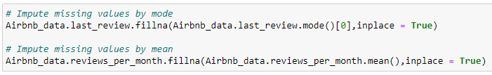
Data Cleaning & Preparation
There are 16 columns & 48,895 records in the Airbnb dataset.
There are 6 Categorical columns of Object datatypes.
There are 10 Numerical values of int & Float datatype, among which id, host_id is converted to STR datatype & last_review is converted to date datatype.
We do not impute name & host_name missing values as the corresponding IDs are present.
Last_review & reviews_per_month missing values are imputed by MODE & MEAN of those columns respectively.
Tools used for Data Cleaning & Analysis are Python & Excel for Data cleaning, Tableau for Analysis.

Slide 10
Insights & Recommendations
04

Slide 11
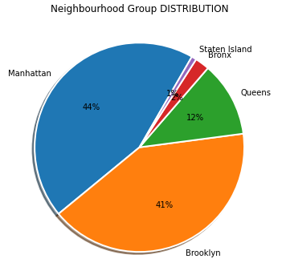
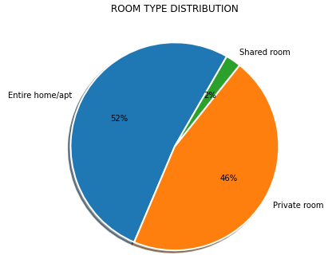
Distribution by Categorical Variables
Manhattan is the city having most of the listings with 44% of entire dataset. The least being in Staten Island only 1%. Brooklyn consisted on 41% listing, 12% in Queens and 2 % in Bronx.
Entire home/apt has 52% and private rooms has 46% of the overall listing. Which explains that overall in New York shared rooms are less preferred and majority of people who opt Airbnb, travel with family or group of friends.

Slide 12
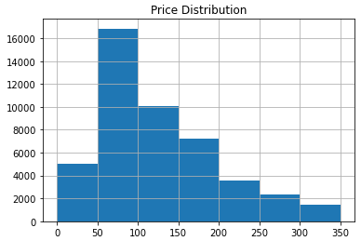
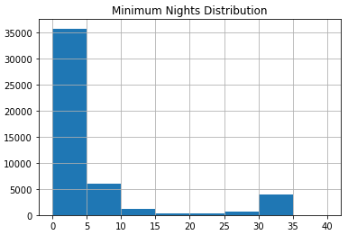
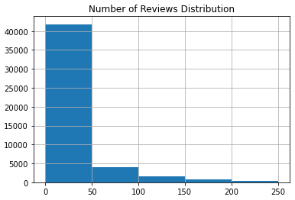
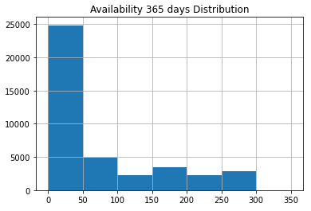
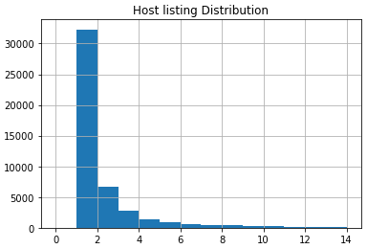
Distribution by Numerical Variables
Looking at the overall distribution irrespective of any categorical variable:
Majority of the listings fall under the Price less than 200$
Majority of the listings offer minimum stay between 1 to 5 nights, followed by 10 to 15 & 30 to 35 nights.
Majority of the listings received reviews between 0 to 50 reviews.
Majority of the listings are available between 1 to 50 days a year, very less listings are available through out the year.
Majority of the Host has only one listing.
NOTE: After checking the quantiles, some outliers were identified and removed from Analysis.

Slide 13
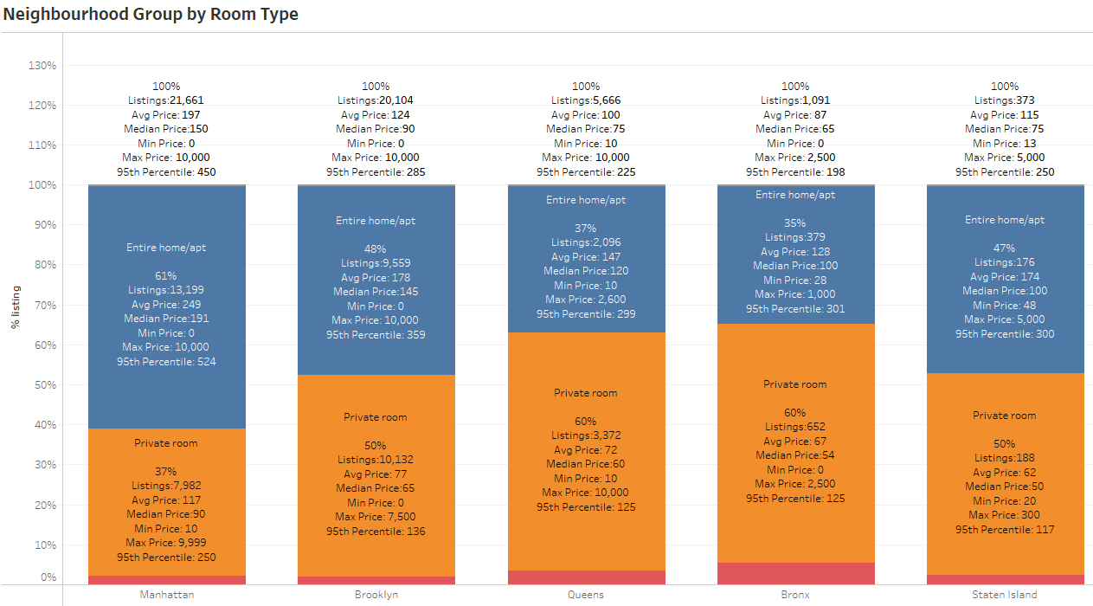
The Room Type “Entire home/apt” and “Private rooms” are preferred more over the shared rooms by Airbnb hosts offering rentals in NYC and they take the majority of the portion among the listed properties in NYC (~97%).
Customer Preference
by Room Type:
Shared Rooms are less listed (~2%) on Airbnb NYC, as it could be that customers less preferred shared rooms in the past.
by Neighbourhood Group:
Properties in Manhattan are most expensive compared to other areas, while in Bronx are least expensive.
Manhattan has higher % of listing in “Entire home/apt” properties compared to all other groups.
Brooklyn has higher % of listing in “Private rooms” properties compared to all other groups.

Slide 14
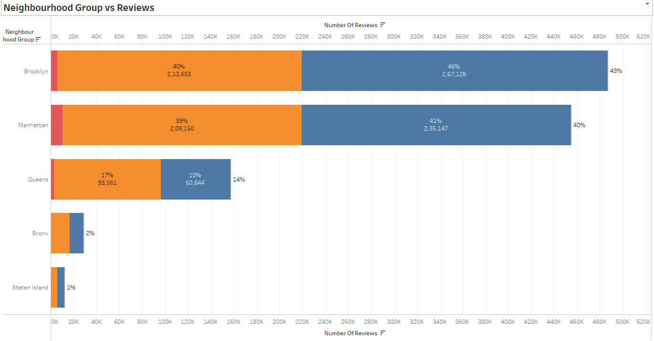
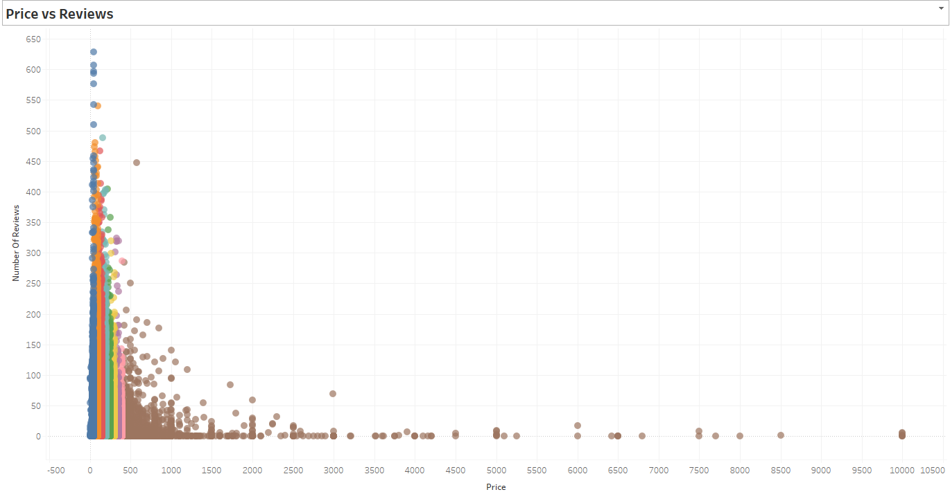
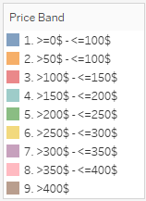

Customer Preference
by Reviews:
by Price:
Majority of Reviews is for Brooklyn though Manhattan has many listings. This could be because, though Manhattan and Brooklyn has major listings, Compared to Manhattan, Brooklyn has better listings with price range 50$ to 100$ (27% Manhattan vs 41% Brooklyn)
Assuming all reviews are positive, as the Price increase, reviews decrease. This shows that customer prefer most budget friendly properties.
Reviews are more for the price range 0$ to 150$.

Slide 15
Recommendations
Looking at the preference by price & reviews, customers look for the properties less than 200$, hence Airbnb should look for some budget friendly properties in Manhattan either by acquiring budget friendly properties or by offering some discounts/ coupons.
Since the price at Bronx are cheaper compared to other Neighbourhood groups Airbnb should focus on acquiring more properties in this area.
Manhattan has more of Entire home/ apt (61%) and less of Private room (37%). Hence Airbnb need to look at increasing Private room properties.
Since majority of listing are available between 1 to 50 days a year (~50% listings), Airbnb should make sure at least 50% of the listings are available almost through out the year to keep the Business up and running all the seasons of the year.

Slide 16
Appendix
05

Slide 17
APPENDIX –ASSUMPTIONS & METHODOLOGY
Assumptions:
We assumed that the Airbnb Business prior to COVID-19 was achieving the desired Revenue.
The Companies Strategies are considered based on the local Govt bodies on uplifting the COVID travel restrictions and the constraints enforced on the travel.
Considered “Number of Review” to be Positive.
Methodology :
Data Preparation & Cleaning: There were 10 Numerical values of int & Float datatypes among which id, host_id was converted to str datatype & last_review was converted to date datatype. Though name and host_name have missing values we have retained the null values as the corresponding IDs are present. last_review & reviews_per_month had null values which was imputed by mode and mean.
Data Analysis: We have used Python and Tableau for analyzing the data through visualization. We identified the outliers in the numeric variables and accordingly excluded the extreme/ outlier values from our analysis. For Analysis we have used bar chart, Stacked bar chart, Pie Chart, Pareto Chart, Scatter Plot and Histogram.
NOTE: Methodology Document along with this presentation would provide much more details.

Slide 18
Thank You

